Slide 1

Systematic Approach to Post-Operative Bedside Assessment
Demonstrate a systematic approach to the post-operative bedside assessment (including attachments, drains, and monitoring) using the case study framework provided
Justify the clinical reasoning behind "early mobilization" and its role in preventing Post-Operative Pulmonary Complications (PPCs).
Apply safety criteria for progressing a patient from sitting-on-edge-of-bed to independent ambulation.
Advanced Physiotherapist
Peter Chong

Slide 2
Step 1: Pre-Assessment Review (Chart and Handover)
Confirm: surgical procedure, date and time, CONFIRM POST OP PROTOCOLCS, any intra-operative complications (prolonged bypass time, transfusion requirement, unexpected findings).
Review: current vital signs trend, fluid balance, drain output over last 4- 8 hours, relevant blood results (Hb, K+, CRP, WCC, coagulation), CXR (most recent), and medications (anticoagulants, vasopressors, sedation, analgesia).
Note: consultant physiotherapy guidelines for this patient, any specific precautions (e.g., sternal precautions, weight-bearing restrictions, anastomotic precautions in lung transplant).
Things to look out for: Where this information can be found?

Slide 3
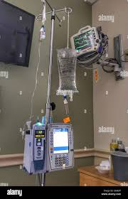
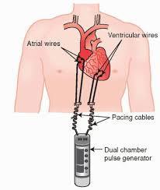
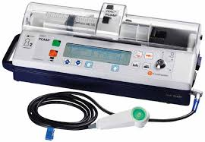
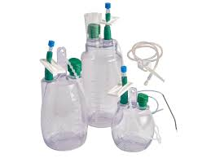
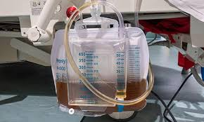
Step 2: Environment and Safety Scan
Identify and document all attachments before approaching the patient: IV lines (peripheral and central), arterial lines, pulmonary artery catheter, urinary catheter, nasogastric tube, chest drains (and their drainage systems - e.g., underwater seal vs. digital drainage), pacing wires (temporary epicardial pacing - critical to be aware of), and any wound drains.
Confirm drain patency and that chest drain tubing is not kinked or clamped during assessment.
Ensure monitoring (continuous cardiac monitoring, SpO2, NIBP) is active and alarmed appropriately.
Have suction available at the bedside, particularly if planning any airway clearance techniques.
Have I liaised with the appropriate staff members? PT, OT, NS, Doctors

Slide 4
Step 3: Patient Assessment - ABCDE
System | Assessment Content
A - Airway | Is the patient self-ventilating or on mechanical ventilation? If extubated: assess voice quality (hoarse = possible vocal cord injury / RLN palsy), cough effectiveness, and presence of secretions. If intubated: confirm ventilator settings (mode, PEEP, FiO2, tidal volumes).
B - Breathing | Respiratory rate (normal 12 - 20 rpm), rhythm, depth. SpO2 (target ≥95% unless documented otherwise). Work of breathing: accessory muscle use, tracheal tug, recession, paradoxical movement. Auscultation: air entry bilaterally, added sounds (crackles - secretions; wheeze - bronchospasm; reduced - collapse/effusion). Inspection: chest symmetry, drain sites.
C - Circulation | HR (rate and rhythm - palpate and confirm on monitor), BP (target typically MAP >65 mmHg; confirm patient-specific target with medical team). Assess for arrhythmia. Peripheral perfusion: skin colour, warmth, capillary refill. Vasopressor infusions - note type and rate (noradrenaline, vasopressin, dopamine). Note drain output since last review.
D - Disability (Neurological) | Level of consciousness (AVPU or GCS). Orientation: person, place, time. Presence of ICU delirium (CAM-ICU score). Pain score (NRS 0–10 or CPOT for non-verbal patients) - document location, character, and impact on movement. Current analgesia and effectiveness.
E - Exposure / Everything Else | Wound inspection (if appropriate): sternal incision, drain sites, leg wound (saphenous vein harvest site). Oedema (peripheral and facial). Temperature. Abdominal distension (relevant for diaphragm function). Lines: are they secure, non-kinked, and at appropriate length for planned mobilisation?

Slide 5
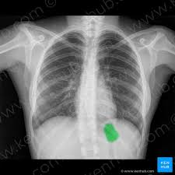
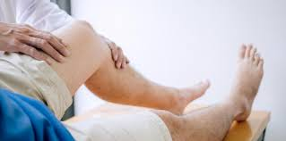
Step 4: Objective Measures
Note of attachments
Subjective Hx
Pain: VAS scale
Auscultation
Secretions
Relevant scans: E.g. CXR
Assess cough strength
Measure Obs: SPO2, HR, RR and BP before any intervention
Functional screen
Range of movement
GCS
Neuro screen (if necessary)

Slide 6
3.2 Clinical Reasoning for Early Mobilisation - Preventing Post-Operative Pulmonary Complications (PPCs)
Post-Operative Pulmonary Complications (PPCs) represent one of the most significant causes of post-surgical morbidity, ICU readmission, and mortality. They include atelectasis, pneumonia, acute respiratory failure, bronchospasm, prolonged mechanical ventilation, and pulmonary embolism.
Evidence Base for Early Mobilisation
Evidence base consisitently demonstrate that early mobilisation (commencing within 24–48 hours post-operatively) reduces rates of PPCs compared to delayed mobilisation.
Upright positioning alone significantly increases FRC (by re-expanding basal lung zones), reduces V/Q mismatch, and improves mucociliary clearance through gravitational assistance.
Active exercise increases tidal volume, promotes deep breathing, enhances lymphatic drainage, reduces venous stasis (DVT/PE prevention), and counteracts the deconditioning that begins within 24 hours of bed rest.
For cardiac surgical patients specifically, early mobilisation has been shown to reduce ICU length of stay, reduce AF incidence, and improve patient-reported recovery quality at 6 weeks.

Slide 7
Physiological Rationale by System
Respiratory: Upright posture shifts the diaphragm downward, increases thoracic volume, reopens collapsed lung units, and improves cough mechanics. Active breathing during exercise increases minute ventilation and promotes collateral ventilation.
Cardiovascular: Orthostatic stress during sit-to-stand activates baroreceptor reflexes, promotes venous return training, and reduces resting heart rate over time. Reduces risk of venous thromboembolism.
Musculoskeletal: Prevents critical illness myopathy (CIM) - a devastating complication of prolonged ICU immobility. ICU-acquired weakness begins within 24 - 48 hours of immobility.
Neurocognitive: Physical activity reduces delirium duration and severity. Providing proprioceptive and vestibular stimulation through upright positioning and movement supports cognitive reorientation.
Digestion: Facilitates bowel movement and constipation

Slide 8
3.3 Safety Criteria for Progressing from Sitting-on-Edge-of-Bed (SOEOB) to Independent Ambulation
Stage | Safety Criteria and Clinical Reasoning
SOEOB (Sitting on Edge of Bed) | HR: Resting <100 bpm; SpO2: ≥94% on current O2 therapy; BP: Systolic 90–180 mmHg; Patient: Alert and able to follow commands; No new arrhythmia; No drain changes indicating haemorrhage; Adequate analgesia in place; Nurse available to assist and monitor
Static Stand (at bedside, supported) | All SOEOB criteria PLUS: No significant postural hypotension (SBP drop >20 mmHg) on sitting; No dizziness or pre-syncope; Adequate lower limb strength to weight-bear; Lines and drains managed safely (not taut, not kinked)
Assisted Ambulation (2–3 metres, with 2 staff) | All standing criteria PLUS: HR increase <30 bpm above resting with standing; SpO2 maintained ≥94%; Patient motivated and able to cooperate; Walking aid selected appropriately for patient's needs and line management
Progressive Ambulation (increasing distances) | Tolerance of short ambulation without: (1) SpO2 drop >4% below resting; (2) HR >120 bpm; (3) Systolic BP drop >20 mmHg or rise >40 mmHg; (4) Borg RPE >14; (5) New chest pain, diaphoresis, palpitations, or pallor
Independent Ambulation (supervised at distance) | Consistent haemodynamic stability across multiple ambulation sessions; Ability to self-monitor symptoms; Adequate drain and line management taught to patient; Physiotherapist or nursing staff within visual range

